Slide 1

Введение в микроконтроллеры ESP8266
Подготовил: Кириленко Иван

Slide 2

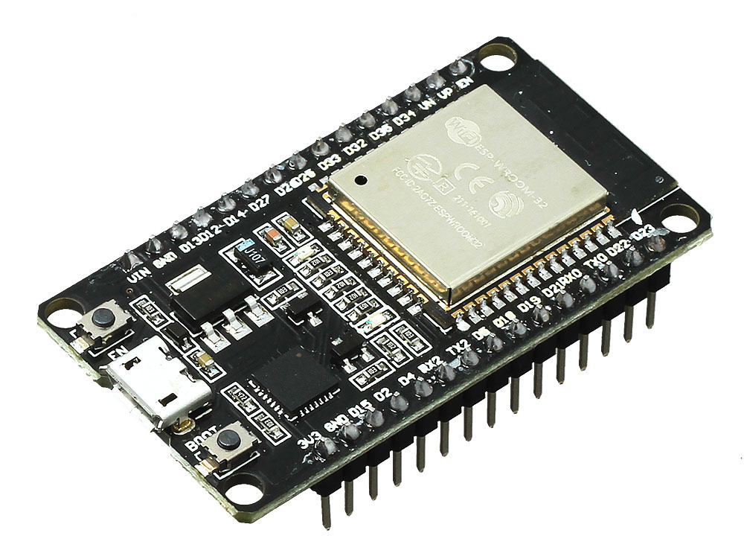
Программирование С/C++
Arduino
ESP32/8266
Wi-fi
Bluetooth

Slide 3
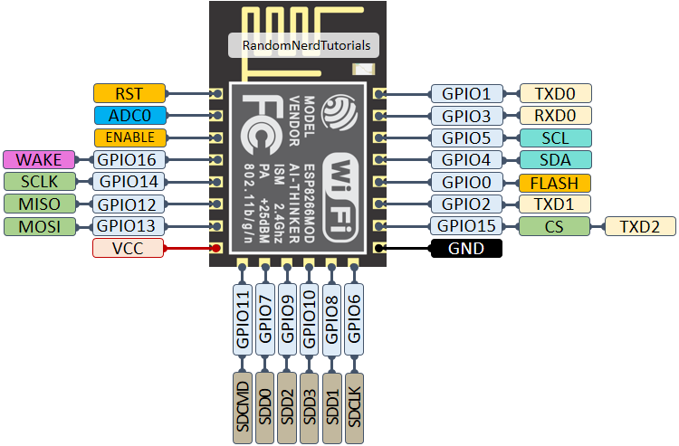
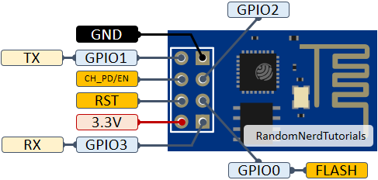
Пины

Slide 4
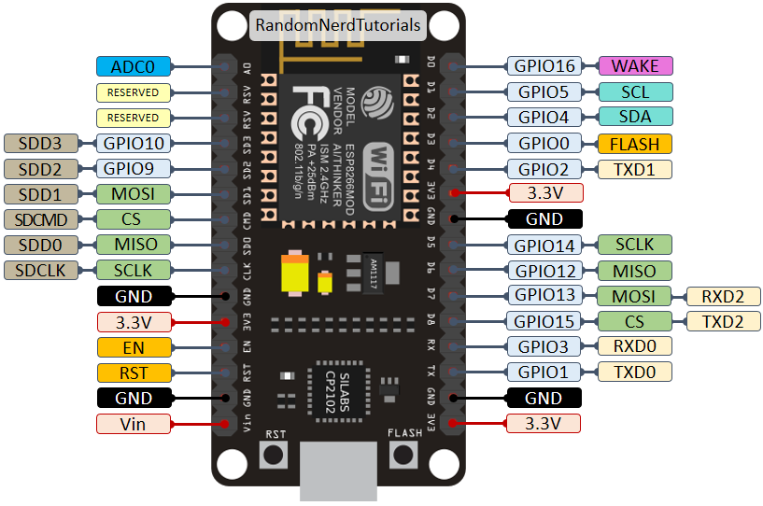
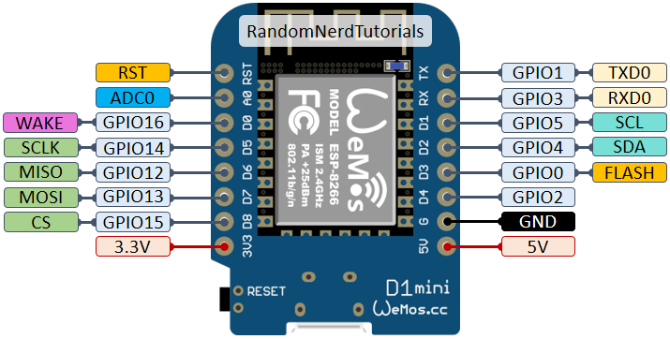
Пины

Slide 5
Label | GPIO | Input | Output | Notes
D0 | GPIO16 | no interrupt | no PWM or I2C support | HIGH at boot used to wake up from deep sleep
D1 | GPIO5 | OK | OK | often used as SCL (I2C)
D2 | GPIO4 | OK | OK | often used as SDA (I2C)
D3 | GPIO0 | pulled up | OK | connected to FLASH button, boot fails if pulled LOW
D4 | GPIO2 | pulled up | OK | HIGH at boot connected to on-board LED, boot fails if pulled LOW
D5 | GPIO14 | OK | OK | SPI (SCLK)
D6 | GPIO12 | OK | OK | SPI (MISO)
D7 | GPIO13 | OK | OK | SPI (MOSI)
D8 | GPIO15 | pulled to GND | OK | SPI (CS) Boot fails if pulled HIGH
RX | GPIO3 | OK | RX pin | HIGH at boot
TX | GPIO1 | TX pin | OK | HIGH at boot debug output at boot, boot fails if pulled LOW
A0 | ADC0 | Analog Input | X

Slide 6
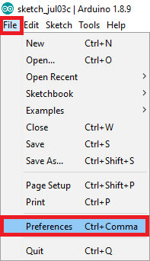
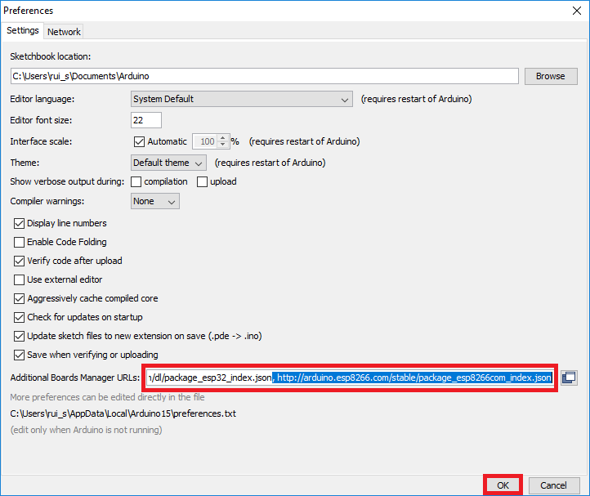
Дополнительная настройка
https://dl.espressif.com/dl/package_esp32_index.json,
http://arduino.esp8266.com/stable/package_esp8266com_index.json

Slide 7


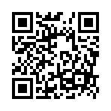
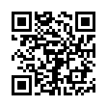

Slide 8

Спасибо за внимание!

